Slide 1
Azure Best Practices
Architecting Complex Solutions with Heavy Loads
By Damir Dobric
Lead Software Architect
Microsoft Regional Director, Azure MVP
https://damirdobric.me
daenet Gesellschaft für Informationstechnologie

Slide 2



Slide 3


Slide 4


Slide 5
Agenda
1 – The true Cloud Pains
2 – Limits of hypes: my lovely Docker
3 – Cannot believe, I chose VMs
4 – Relativity Theory of load balancing
5 – Recap

Slide 6
The TRUE cloud PAINs

Slide 7






We will use today following services

Slide 8
We will use today following services
docker
acr
batch
appervice
aci
az

Slide 9
Limits of Hype: My lovely docker
💓

Slide 10
Dynamic of RAM
Operative System
Physical memory Boundary
Process Private Memory
Process
Large Object(s) inside of process

Slide 11
Dynamic of RAM
Operative System
Physical memory Boundary
Process Private Memory
Process
Large Object(s) inside of process

Slide 12
Dynamic of RAM
Operative System
Virtual memory
Process Private Memory
Operative System
Physical memory Boundary
Process
Large Object(s) inside of process

Slide 13
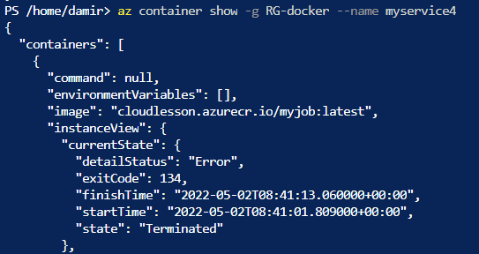
Killing my Docker softly
Inspect the container
Exit Code 134
Abnormal termination (SIGABRT)
Container Abnormally Terminated itself
Status Out of Memory
Exit Code 137
Immediate Termination (SIGKILL)
Docker Kill
Status OOMKilled

Slide 14
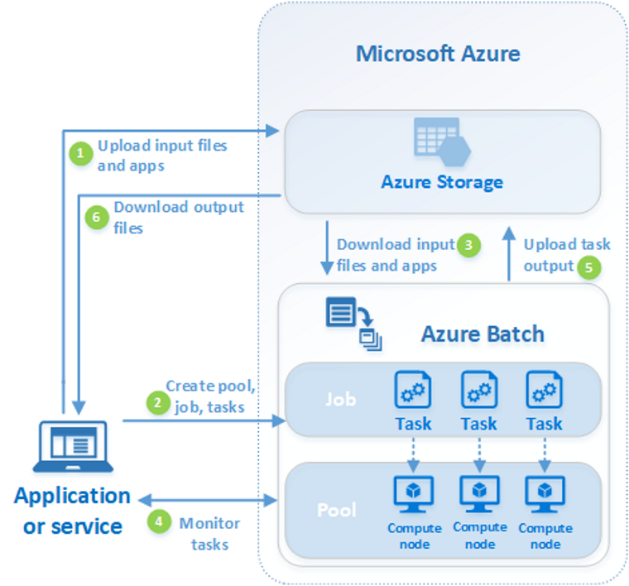
Azure Batch Service
We upload the job executable file to the storage. (2)
We create a task associated with executable file. (3)
We drive deployment from here (1)
We can scale over pool of reserved VMs.

Slide 15
Relativity Theory of Load Balancing
Hosting large objects as a service

Slide 16
Processing of requests in ASP.NET WebApi
Thread
Object
Thread
Object
Thread
Object
Thread
Object
Thread
Object
Thread
Object
HTTPS Requests
Thread
Object
Thread
Object
Thread
Object
Thread
Object
Thread
Object
Thread
Object
Thread
Object
Thread
Object
[HttpGet("ping/{arg}")]
public async Task<string> Ping(int arg)
{
var obj = new MyObject(null);
var res = await obj.Run(delay);
return res;
}

Slide 17
Large objects are limited by available RAM
Object
Thread
Object
HTTPS Requests
Thread
Object
Thread

Slide 18
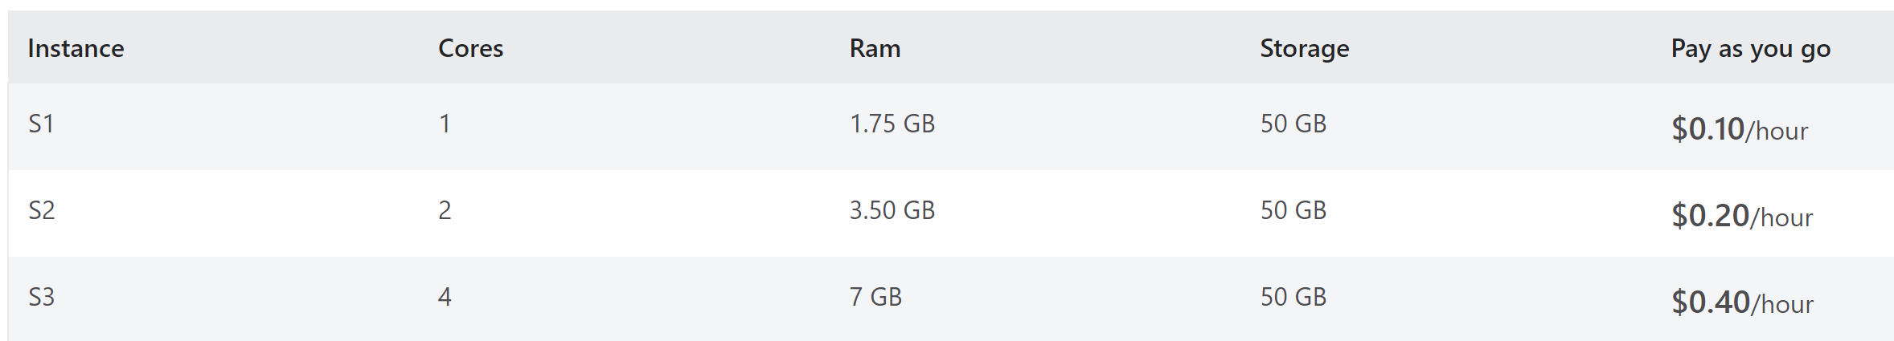
What now?
We can scale vertically
We cannot scale horizontally
This increases costs

Slide 19
Large Object as a Service

Slide 20
Object Pool Pattern
ASP.NET WebApi
Thread 1
Object
Thread 2
HTTPS Requests
Object
Thread 3
Object
Thread 4

Slide 21
Object Pool Pattern
ASP.NET WebApi
Thread 1
Object
Thread 2
HTTPS Requests
Object
Thread 3
Object
Thread 4

Slide 22
Object Pool Pattern
ASP.NET WebApi
Thread 1
Object
Thread 2
Object
HTTPS Requests
Thread 3
Object
Thread 4

Slide 23
Object Pool Pattern
ASP.NET WebApi
Thread 1
Object
Thread 2
Object
HTTPS Requests
Thread 3
Object
Thread 4

Slide 24

Object Pool Pattern
ASP.NET WebApi
Thread 1
Object
Thread 2
Object
HTTPS Requests
Thread 3
Object
Thread 4

Slide 25
Object Pool Pattern with “WAIT QUEUE”
ASP.NET WebApi
Thread 1
Object
Thread 2
Object
HTTPS Requests
Thread 3
Object
Thread 4

Slide 26
Object Pool Pattern with “WAIT QUEUE”
ASP.NET WebApi
Thread 5
Thread 2
Object
HTTPS Requests
Thread 3
Object
Thread 4
Object

Slide 27
Slow down request processing ?
Memory = Space
Request processing time
SERVICE
Time Dilation
You can save the space if you slower the processing time

Slide 28
Recap
Docker or Batch?
Dynamic memory Consumption can be an issue for Docker
Azure Batch Service is a valid solution
Hosting Large Objects as a Service
We can keep the size and costs
But we must slow down processing (time dilation)

Slide 29
Questions & Answers
Damir Dobric
Lead Software Architect
Microsoft Regional Director, Azure MVP
https://damirdobric.me

Slide 30






Visit us....
Get your feedback:
https://daenet.de/de/contact/
https://daenet.de/de/
https://www.meetup.com/azure-meetup-frankfurt/
https://developers.de/
https://www.linkedin.com/company/daenet
https://fb.watch/7p-_oFJhxl/
https://www.instagram.com/daenetcommunity/
https://twitter.com/daenetv
Copyright @daenet 2021

